Slide 1
CLIENT SERVER IMPLIMENTATION.
CLIENT SERVER PROGRAMMING IN PYTHON

Slide 2
Group members
Joel Nganga SCT212-0578/2022
Stephen Kariuki SCT212-0527/2022
Anold Macharia SCT212-0727/2022
Fidelity Kathure SCT212-0718/2022
Fredrick Mbai SCT212-0146/2022

Slide 3
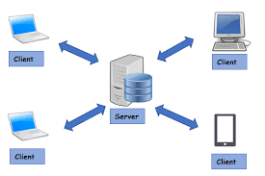
WHAT IS A CLIENT SERVER
A client-server model is a networking computing system design that illustrates a relationship between two or more computers, where the client computers request and receive services or resources from a powerful centralized server computer. It describes a specific way devices access the information you store in servers.

Slide 4
What is a client server network
Client-server network is the medium through which clients access resources and services from a central computer, via either a LAN and a WAN, such as the internet.it also stores data, manage/provide resources, and control user access (server).
A unique server may be employed for the sole purpose of awaiting client requests, at which point the network connection is initiated until the client request has been fulfilled.

Slide 5
CLIENT SERVER
Sockets can be configured to act as a server and listen for incoming messages, or connect to other applications as a client. After both ends of a TCP/IP socket are connected, communication is bi-directional.
This sample program, based on the one in the standard library documentation, receives incoming messages and echoes them back to the sender. It starts by creating a TCP/IP socket. For example import socket
Data is read from the connection with recv() and transmitted with sendall(), just as in the server.
When communication with a client is finished, the connection needs to be cleaned up using close()

Slide 6
CODE DEFINITION
port
A numerical identifier that uniquely identifies a process that is running on a device and handles particular network communications: when we run a server we need to pick a port that we’re going to run it on.
Sockets
Sockets and the socket API are used to send messages across a network. They provide a form of inter-process communication (IPC). The network can be a logical, local network to the computer, or one that's physically connected to an external network, with its own connections to other networks.
socket_type
The type of socket used by the server; socket.SOCK_STREAM and socket.SOCK_DGRAM are two common values.
server_address
The address on which the server is listening. The format of addresses varies depending on the protocol family.
Server_close
Clean up the server. May be overridden.

Slide 7
CODE DEFINITION
Client address
Client address returned by BaseServer.get_request().
Server
Base Server object used for handling the request.
bind
The bind() method of Python's socket class assigns an IP address and a port number to a socket instance.
The bind() method is used when a socket needs to be made a server socket.
As server programs listen on published ports, it is required that a port and the IP address to be assigned explicitly to a server socket.
For client programs, it is not required to bind the socket explicitly to a port. The kernel of the operating system takes care of assigning the source IP and a temporary port number.
The client socket can use the connect() method, after the socket creation is complete to contact the server socket.

Slide 8
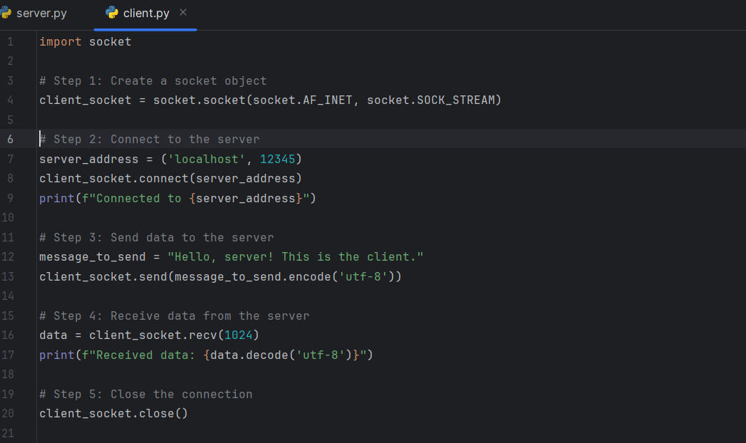
CLIENT CODE

Slide 9
Create a socket object:
Same as in the server, socket.socket(socket . AF_ INET, socket.SOCK_STREAM) creates a new socket object using IPv4 (AF_INET) and TCP (SOCK_STREAM).
Connect to the server:
Client _ socket. connect (server _ address) connects the client socket to the specified server address.
Send data to the server:
Client _ socket . send(message _ to_ send . encode('utf-8')) sends a message to the server.
Receive data from the server:
data = client_socket.recv(1024) receives data from the server.
Close the connection:
Client _ socket. close() closes the client socket.

Slide 10
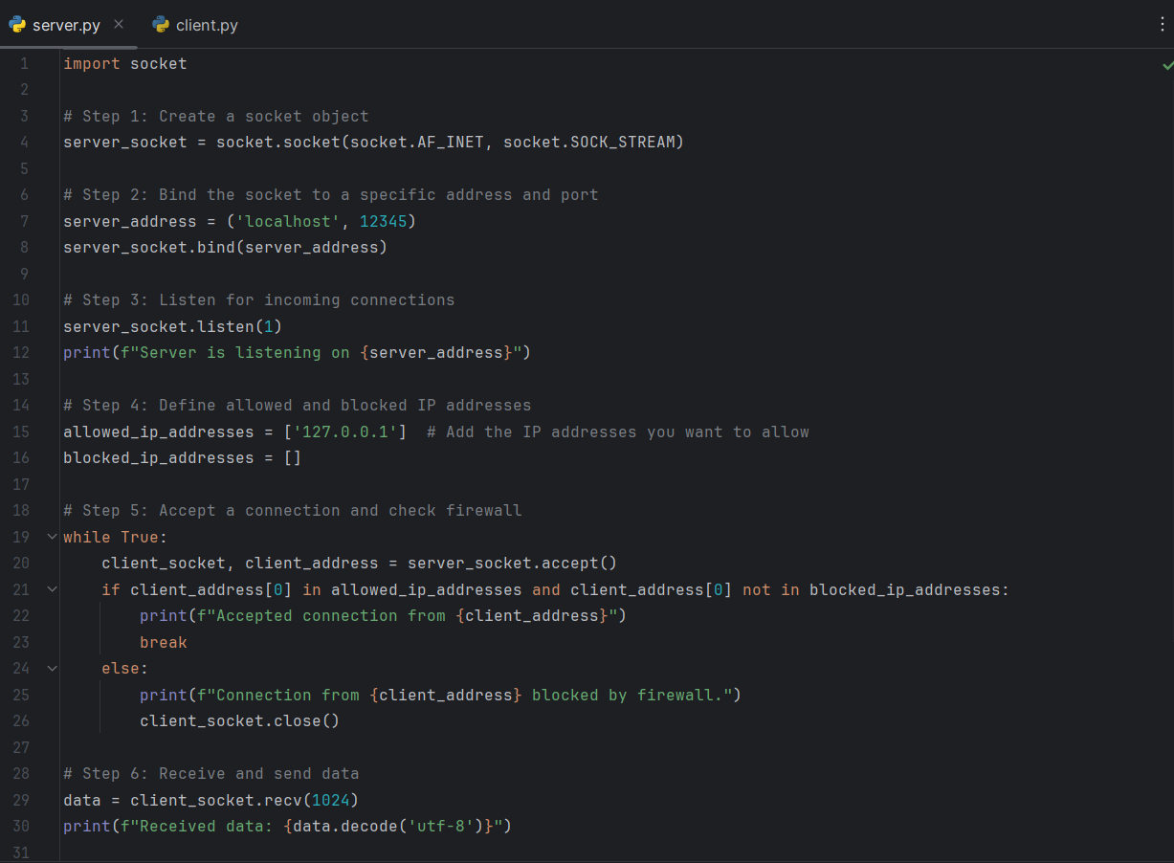
SERVER CODE

Slide 11
Steps explained
Create a socket object:
socket.socket(socket . AF_INET, socket.SOCK_STREAM) creates a new socket object using IPv4 (AF_INET) and TCP (SOCK_STREAM).
Bind the socket to a specific address and port:
Server _ address = ('localhost', 12345) defines the server's address and port number.
Server _ socket . bind(server _ address) binds the server socket to the specified address.
Listen for incoming connections:

Slide 12
Server _ socket . listen(1) makes the server listen for incoming connections. The argument specifies the maximum number of queued connections.
Accept a connection:
Client _ socket, client _ address = server_socket.accept() accepts an incoming connection. It returns a new socket representing the connection and the address of the client.
Receive and send data:
data = client _ socket . recv(1024) receives data from the client (up to 1024 bytes).
Client _ socket . send(message _ to _ send . encode('utf-8')) sends a message to the client.
Close the connection:
Client _ socket . close() and server _ socket . close() close the client and server sockets, respectively.

Slide 13
CONCLUSION
Whether a computer is a client, a server, or both, is determined by the nature of the application that requires the service functions.
For example, a single computer can run a web server and file server software at the same time to serve different data to clients making different kinds of requests.
THE END…

